Slide 1

Project 3 Data Cleaning
Romain Courtois
Hye-Jin Cho-Drugeon​

Slide 2
Data Description
Data Description
train.csv: 45,211 rows and 18 columns ordered by date (from May 2008 to November 2010)
test.csv: 4521 rows and 18 columns with 10% of the examples (4521), randomly selected from train.csv
Aim
direct marketing campaigns of a Portuguese banking institution. The marketing campaigns were based on phone calls.
Finances
Term deposits are a major source of income for a bank. A term deposit is a cash investment held at a financial institution. Your money is invested for an agreed rate of interest over a fixed amount of time, or term. The bank has various outreach plans to sell term deposits to their customers such as email marketing, advertisements, telephonic marketing, and digital marketing.

Slide 3

bank client data
1 - age (numeric) 2 - job : type of job (categorical: "admin.","unknown","unemployed","management","housemaid","entrepreneur","student", "blue-collar","self-employed","retired","technician","services") 3 - marital : marital status (categorical: "married","divorced","single"; note: "divorced" means divorced or widowed) 4 - education (categorical: "unknown","secondary","primary","tertiary") 5 - default: has credit in default? (binary: "yes","no") 6 - balance: average yearly balance, in euros (numeric) 7 - housing: has housing loan? (binary: "yes","no") 8 - loan: has personal loan? (binary: "yes","no")

Slide 4
bank client data
9 - contact: contact communication type (categorical: "unknown","telephone","cellular") 10 - day: last contact day of the month (numeric) 11 - month: last contact month of year (categorical: "jan", "feb", "mar", …, "nov", "dec") 12 - duration: last contact duration, in seconds (numeric) # other attributes: 13 - campaign: number of contacts performed during this campaign and for this client (numeric, includes last contact) 14 - pdays: number of days that passed by after the client was last contacted from a previous campaign (numeric, -1 means client was not previously contacted) 15 - previous: number of contacts performed before this campaign and for this client (numeric) 16 - poutcome: outcome of the previous marketing campaign (categorical: "unknown","other","failure","success")

Slide 5

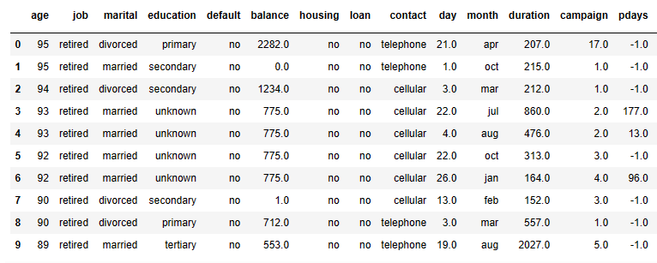
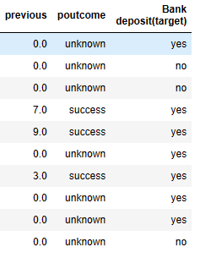
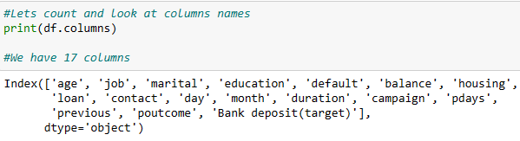
Step1 Data frame head10

Slide 6
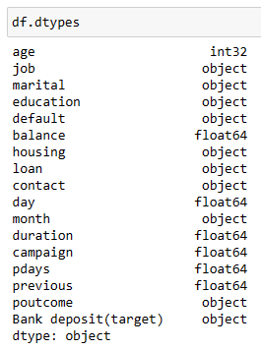
#marital encoding column "marital" as numeric (married: 1 divorced: -1, single; 0)
#education, 27 missing value, 2 bad input (hjkl-unknown, Tertiary-moved to tertiary) / Unknown 717 + 1 (6 percents)
#default, binary, most frequent method (98 percent confidence)
#balance, string needed to be float,
#loan, 12 omitting variables, binary, most frequent method (98 percent confidence)
#contact unknown + 1 bad input (26 percent) except for cellular and telephone
# month 8 omitting
# campaign: max 43 times for contacting. normal distribution (maybe)
# pdays, previous: pdays(new customers as -1) and previous's comparison
# poutcome, no missing but 9214 unknown variables (encoding column "poutcome" as numeric (unknown: 0 failure: -1, success; 1 other 0))
# Bank deposit
Challenge
6 rows, empty
Meta data (4521 rows)
Each column has each problem

Slide 7
Data Analysis descriptive statistics
Clean data

Slide 8
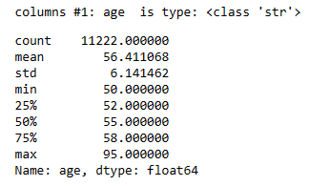
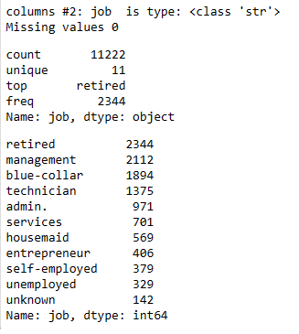
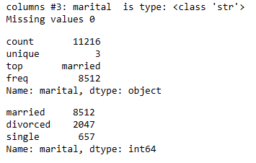
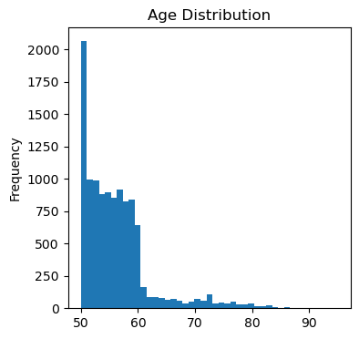
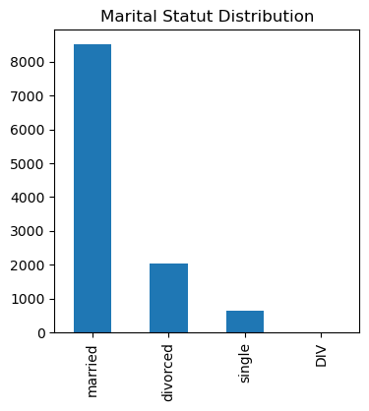
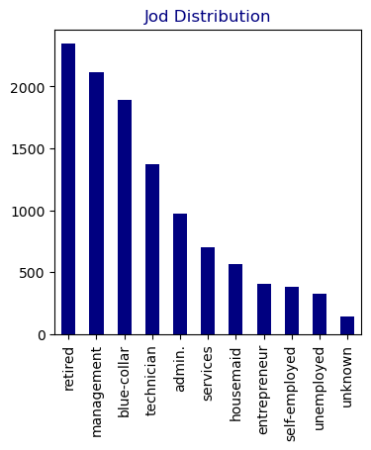

Slide 9
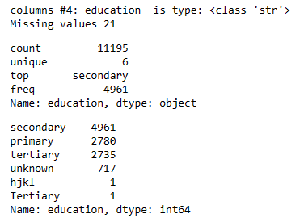
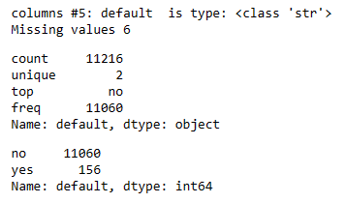
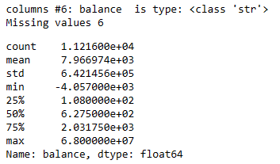
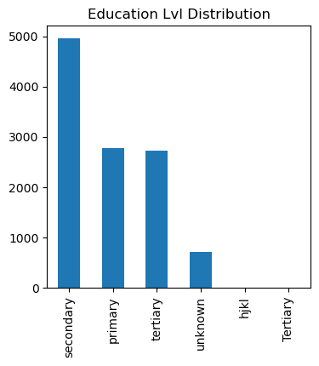
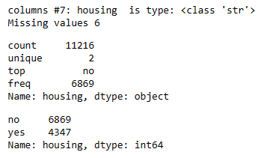
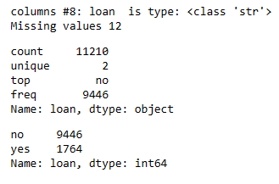

Slide 10
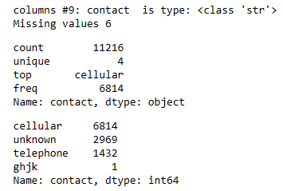
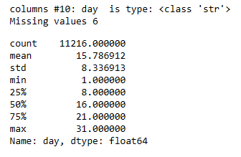
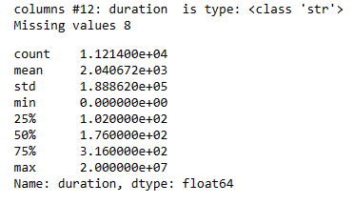
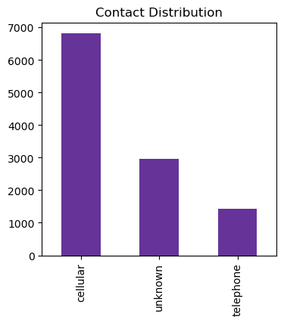
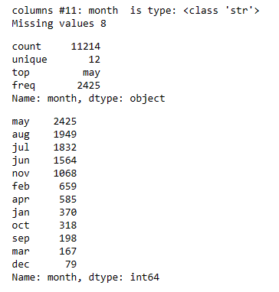
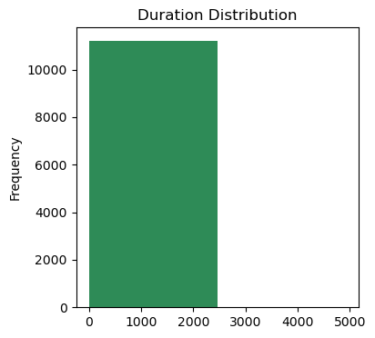

Slide 11
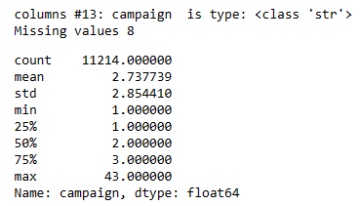
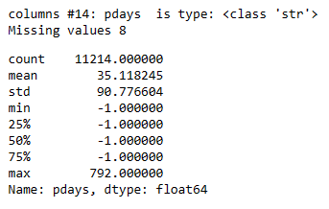
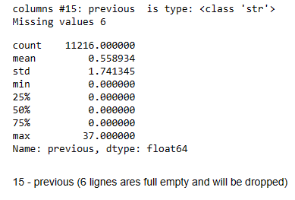
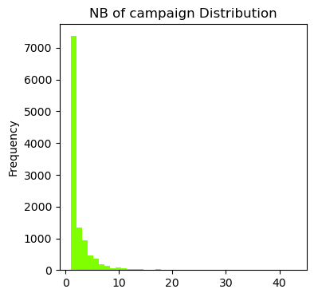
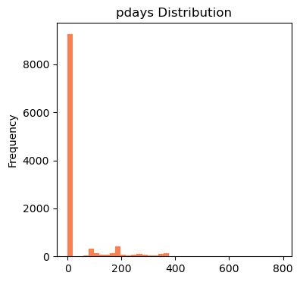
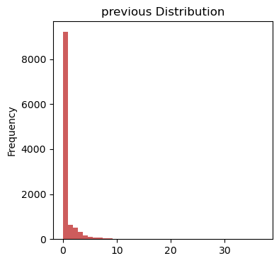

Slide 12
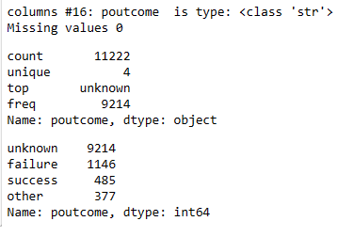
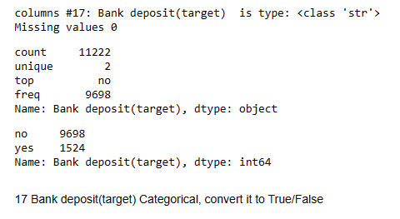
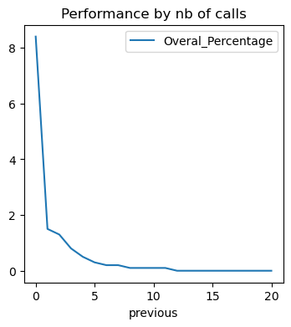
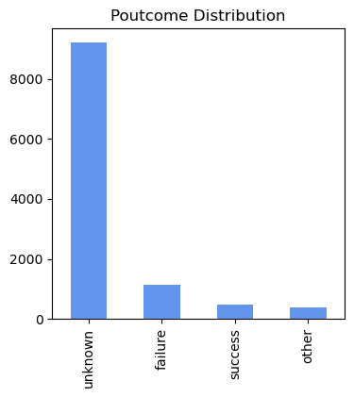
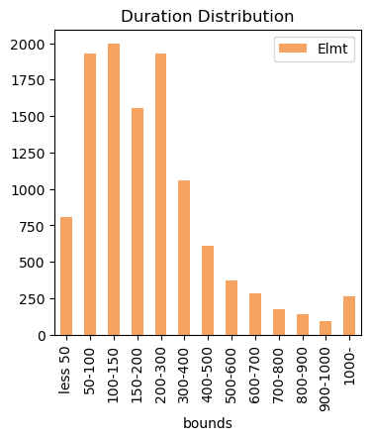

Slide 13
Process
Analysis of each column

Slide 14
#Step 0: 6 lignes ares full empty and will be dropped
df = df.drop(df[df['marital'].isna()].index)
#4 - education
#27 missing value, we'll try to impute it using KNN method
#717+1 unknown (6%), we will see wich impute strategy is best by testing them
#2 bad imput hjkl -> unknown, Tertiary -> tertiary
#df.loc[(df['education'].str.strip() == 'primary') & (df['education'].str.strip() == 'secondary') & (df['education'].str.strip() == 'tertiary') & (df['education'].str.strip() == 'unknown')]#,'education'] = 'tertiary'
df.loc[df['education'] == 'hjkl','education'] = 'unknown'
#df["education"].str.replace(r'(.*Terti.*)','tertiary', regex=True,)
#1 - age (numeric) is in string format and should be convert to integer (age)
df['age'] = df['age'].astype('Int64')
# 3 - marital : 1 bad imput 'DIV' must be relace by 'divorced', really low impact,
#We encode it in a new column as a numerical category {'married': 1, 'divorced' : -1, 'single' : 0}
df.loc[df['marital'] == 'DIV','marital'] = 'divorced'
df["n_marital"] = df["marital"].map({'married': 1, 'divorced' : -1, 'single' : 0})

Slide 15
#8 - loan Categorical, convert it to True/False
#Missing values 12 ( - 6 dropped ligne) = 6 low impact. We impute then using most frequent n
df.loc[df['loan'].isna(),'loan'] = 'no'
df['b_loan'] = df['loan'] == 'yes'
# 4 - education (categorical: "unknown","secondary","primary","tertiary")
print('columns #4:', df.columns[3] , ' is type:', type( df.columns[3]) )
print('Missing values',df['education'].isna().sum())
display(df['education'].describe())
print(df['education'].value_counts() )
#9 - contact:
# 1 Bad input ghjk -> unknown
df.loc[df['contact'] == 'ghjk','contact'] = 'unknown'
#5 - default
#Categorical, convert it to True/False
df['b_default'] = df['default'] == 'yes'
#10 - day part of date, need to be concat with month in a date
# 11 - month
# 2 missing val We impute the 2 ligne using most frequent : may
df.loc[df['month'].isna(),'month'] = 'may'
#6 - balance is string, need to be converted to float(2)
df['balance'] = df['balance'].astype(float)
# 7 - housing: has housing loan? (binary: "yes","no")
df['b_housing'] = df['housing'] == 'yes'

Slide 16
#12 - duration
# 8 - 6 Missing values (6 lignes ares full empty and will be dropped); We impute the 2 ligne using mean = 2040 (before removing 2E7 values) after 257.2:
# Max is 20 000 000s = > 231 days let's investigate , 2nd max = 4918s -> 20 000 000 value will have the mean assigned
df = df.drop(df[df['duration'] == 20000000].index)
df.loc[df['duration'].isna(),'duration'] = 257
#15 - previous
#16 - poutcome
#We can try to encode it as a numerical category {'unknown': 0, 'success' : 1, 'failure' : -1, 'other' : 0}
df["n_poutcome"] = df["poutcome"].map({'unknown': 0, 'success' : 1, 'failure' : -1, 'other' : 0})
#17 Bank deposit(target)
#Categorical, convert it to True/False
df['b_deposit'] = df['Bank deposit(target)'] == 'yes'
#13 - campaign
#We impute the 2 ligne using mean 3
df.loc[df['campaign'].isna(),'campaign'] = 3
#14 - pdays:
#We impute the 2 ligne using mean 3
df.loc[df['pdays'].isna(),'pdays'] = 35

Slide 17
Using sqlalchemy to connect to Database

Slide 18
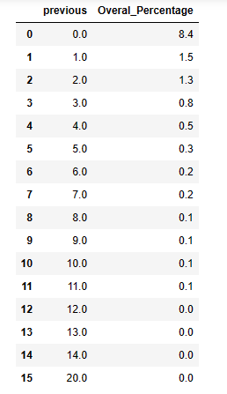
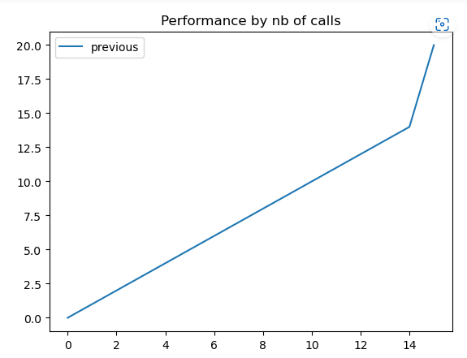
#Read the view v_performance_by_nb_call

Slide 19
Thank you

